Slide 1
Unit 7
Solving Systems of Equations by Graphing
Algebra 1

Slide 2
Solving Systems of Linear Equations by Graphing
STEPS
Graph both equations on the same coordinate system..
The point of intersection is the solution to the system of equations.

Slide 3
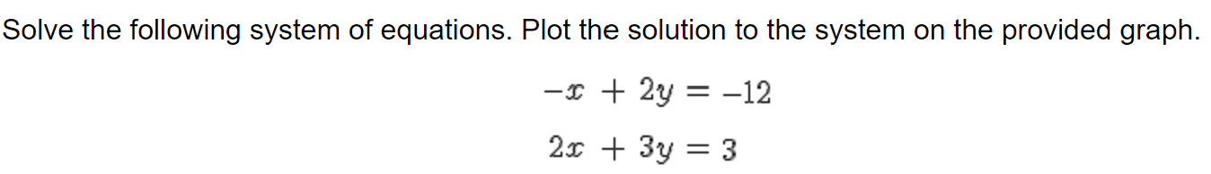
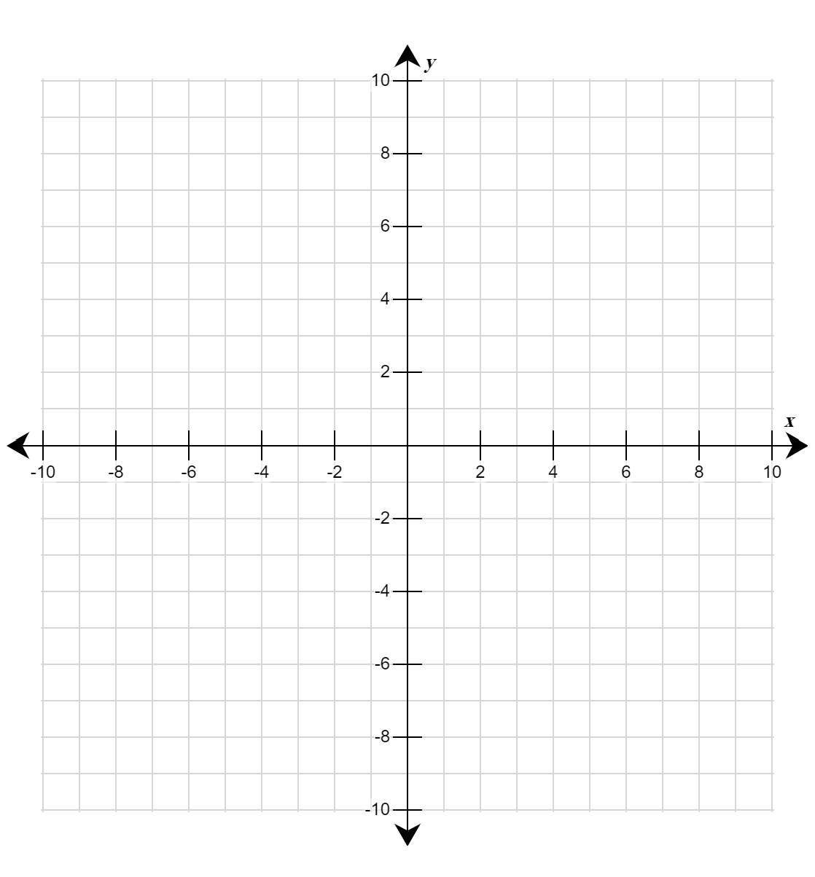

Slide 4
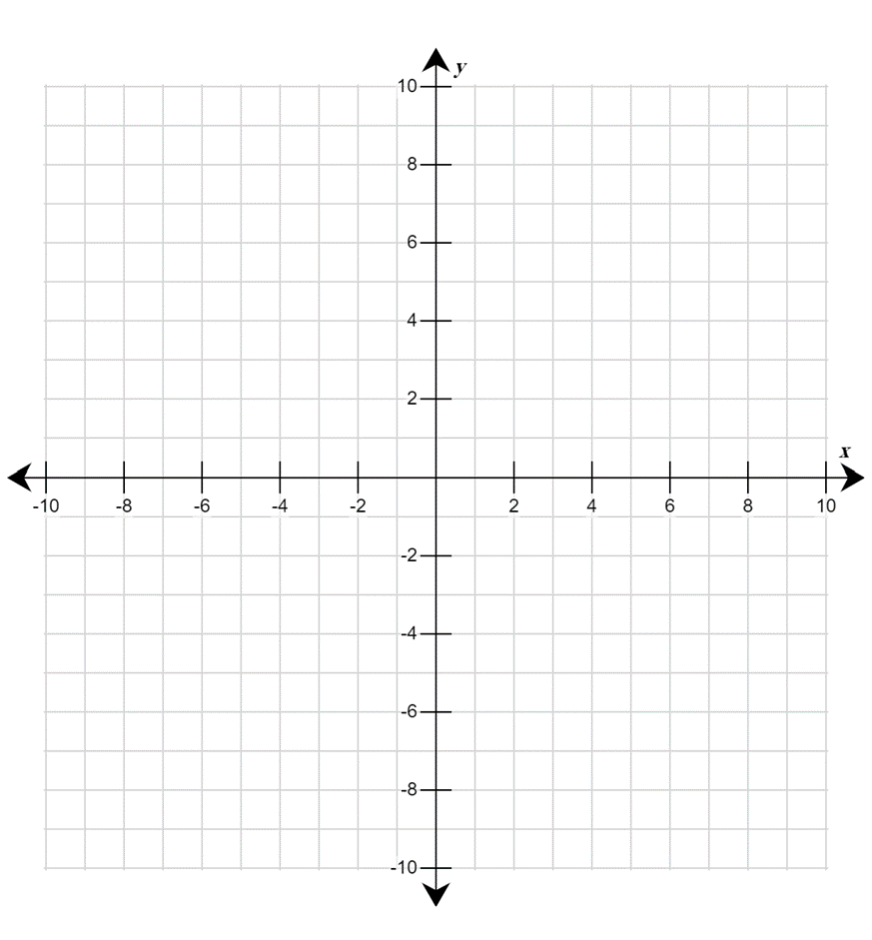


Slide 5
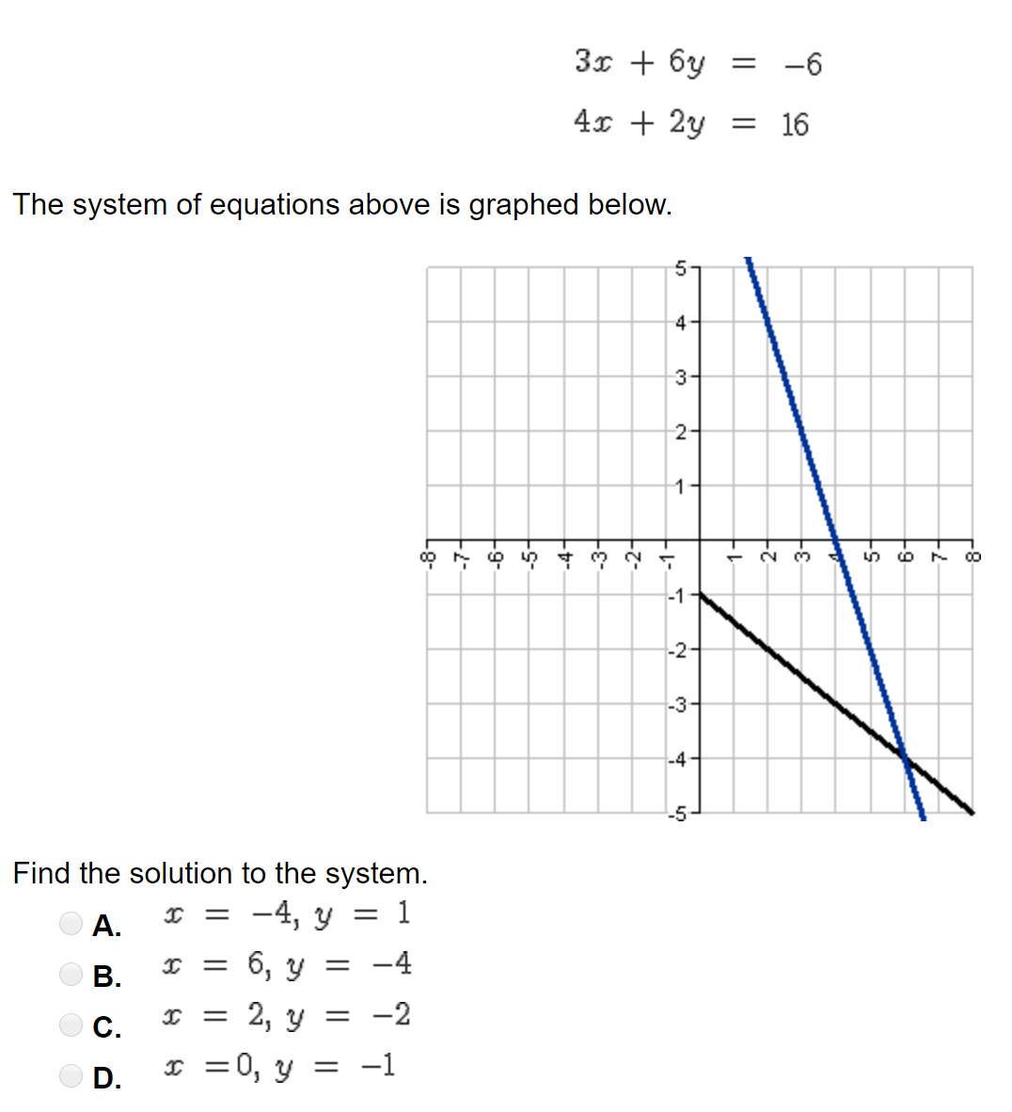
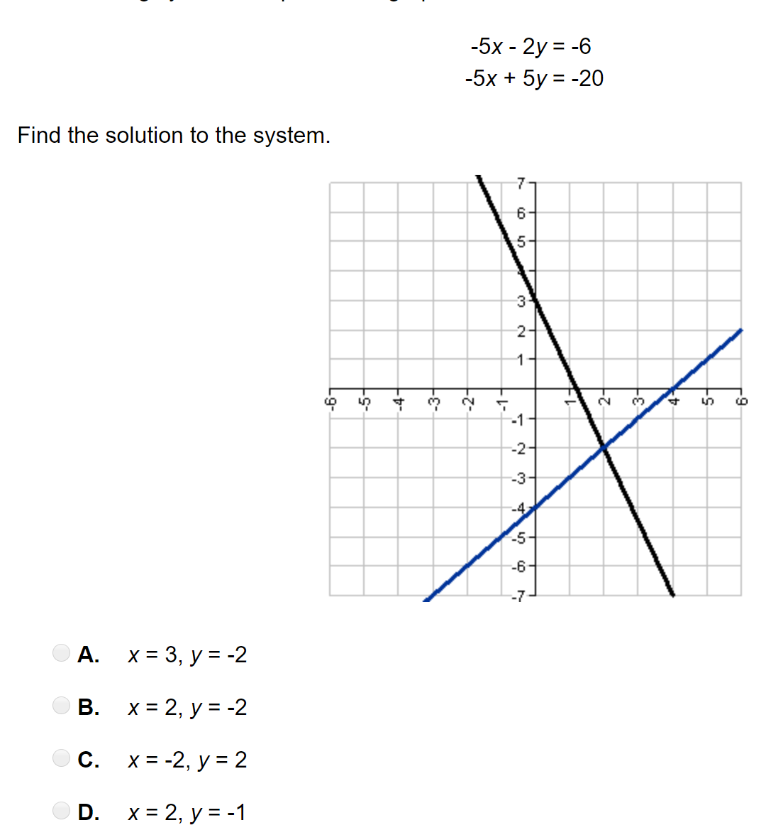

Slide 6
